Slide 1
Traffic Simulator Calibration
Dr. Baker Abdalhaq

Slide 2
Outline
Traffic simulators
Calibration
Calibration methods
GA, TS, PS,SPSA
Some results
Further work

Slide 3
Traffic Simulators/models
Macroscopic
Flow -Physics
Microscopic
Every single vehicle (physical+ behavioral)
Mesoscopic
queue
Sub-Microscopic
Engine rotation speed, driver gear switch…etc.

Slide 4
Calibration
Good input -> good outputs
Some parameters are difficult to be obtained or estimated.
Calibration is optimization
simulator
input
output
Minimize
error
Error (difference)
Real world
variables
observations

Slide 5
Calibration Methods
Classical
Gradient based
Simplex (Nelder-Mead, COBYLA)
Heuristic
Genetic
Tabu
Particle Swarm
SPSA

Slide 6
Genetic
Randomly generate the first population of individuals potential solutions
Evaluate the fitness function for each population member
While not ( number of iteration reached) : obtain a new generation by repeat
Selection of two individuals (or more)
Crossover of selected individuals
According the mutation probability, randomly mute the output of previous step.
Until a new population has been completed.
end while

Slide 7
Particle Swarm
// initial swarm usually random
for each particle :
for each dimension i
// calculate velocity
// update particle position
While stop criteria not reached, Go to step 02

Slide 8
Simplex

Slide 9
Taboo
Generate initial solution θ
While not finished
identify N(θ) (Neighborhood set) by applying moves
Identify T(θ) (tabu set)
identify A(θ) (aspiration set)
choose θ' in N(θ)-T(θ) U A(θ), for which f(θ') is optimal
change θ by θ'
End wile

Slide 10
SPSA
Step 1: Initialization
Set k=0
Pick initial guess of and nonnegative coefficients (a,c,A,α and )
Step 2: Generation of Simultaneous Perturbation Vector
Generate which is a Bernoulli distribution with probability of 0.5 for each +1 or -1 outcome
Step 3: Loss Function Evaluations
Obtain two measures of the function:
and
Step 4: Gradient Approximation
Step 5: Update estimate
Step 6: iteration or termination
If termination condition not met, return to step 2 with k+1 replacing k.

Slide 11
SUMO input parameters
Parameter Max Min unit Description
Sigma 1 0.0 - Driver imperfection
Acceleration 0.3* 2.9* m/s^2 Ability of the car to accelerate
Deceleration 0.5* 4.9* m/s^2 Ability of the car to decelerate
Length 2 10 m Car length with leading gap
Max speed 120 10 km/h Max allowed speed

Slide 12
Parameter Selection
Parameter | Correlation (5'000 random runs) | Parameter Importance index (PII) (formula 7) (5'000 random runs)
Length | -0.06 | 0.95
Deceleration | -0.11 | 0.86
Sigma | 0.15 | 0.84
Acceleration | -0.23 | 0.7
Max speed | -0.02 | 0.63

Slide 13
Error Measurement

Slide 14
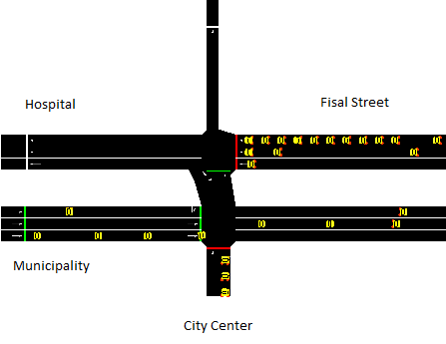
Site 1

Slide 15
Algorithms Performance Comparison
Algorithm | Minimum fitness |  | Maximum fitness |  | Average fitness | Number of Fitness function executions
GA1 | 0.076 | 0.096 |  |  | 0.087 | 1250
GA2 | 0.071 | 0.105 |  |  | 0.090 | 1250
PS | 0.071 | 0.098 |  |  | 0.079 | 1034
dTS | 0.066 | 0.089 |  |  | 0.079 | 1000
sTS |  |  |  |  | 0.083 | 1000
SPSA | 0.069 | 0.077 |  |  | 0.073 | 1000
NM(Globalized) | 0.090 | 0.117 |  |  | 0.104 | 1240
COBYLA(Globalized) | 0.090 | 0.124 |  |  | 0.104 | 1220

Slide 16
Comparison results

Slide 17
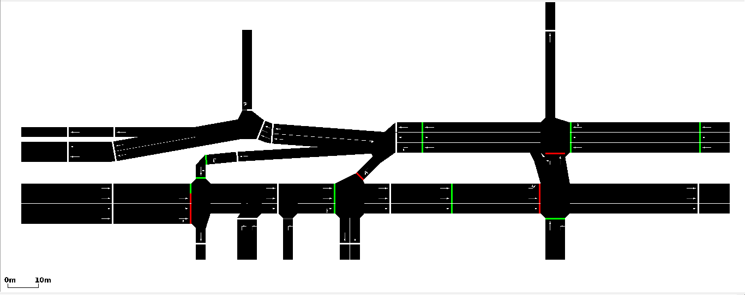
Site 2

Slide 18
Algorithm | Minimum fitness | Maximum fitness | Average fitness | Number of Fitness function executions
GA2 | 0.103 | 0.184 | 0.146 | 1250
GA1 | 0.130 | 0.175 | 0.154 | 1250
PS |  |  | 0.144 | 1034
dTS |  |  | 0.166 | 1000
sTS |  |  | 0.154 | 1000
SPSA |  |  | 0.167 | 1000
NM(Globalized) | 0.164 | 0.229 | 0.187 | 1239
COBYLA(Globalized) | 0.156 | 0.205 | 0.172 | 1297

Slide 19
Further work
Comparing Algorithms using other problems
Minimizing Co2 by changing traffic light schedule

